Slide 1

The Rules of Chess
abd15 – Abdullah
mib60 - Micah

Slide 2



Agenda
Objective of Chess
Rules of Chess
Rules of pieces
Special Rules
Probable System tests

Slide 3

Introduction : Objective of Chess
The objective of chess is to checkmate the king.
The word checkmate means that there is no way for the king to move to a place where he is safe from The enemy pieces on the next turn such that he is captured on the next turn.
There is a lesser checkmate called check this is called out when the king will be captured on the next turn but the king can escape.if he does a specific move.
This is done by using the pieces together on the board such as the Bishop, Rook, Knight, Pawn, and Queen.

Slide 4

Rules of chess

Slide 5
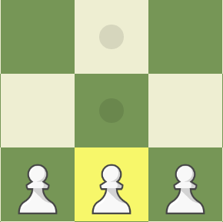

The Pawn
Moves 1 place forwards
Can move 2 places on it’s first move
Cannot move back
Captures 1 space forward diagonally
Has Promotions

Slide 6
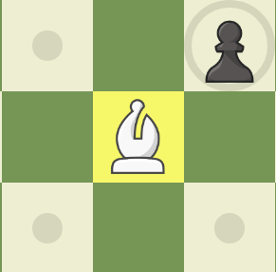

The Bishop
Only Moves Diagonally for infinity
Captures Diagonally on its trajectory
Can move Forwards and Back
Have 2 of them one on the Dark Squares and one on the Light Squares

Slide 7

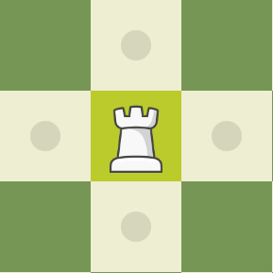
The Rook
Moves in a straight line infinitely
Captures on its trajectory
Can move back, Front, Left, and Right

Slide 8
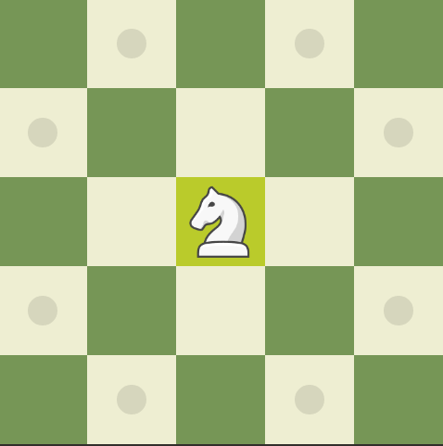
The Knight
Moves in a L shape radially
Captures by landing on the piece at the tip of the L

Slide 9
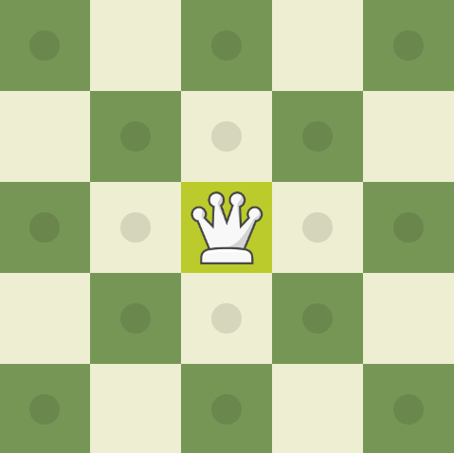
The Queen
Acts as a combination of the Bishop and the rook
Captures in its trajectory

Slide 10
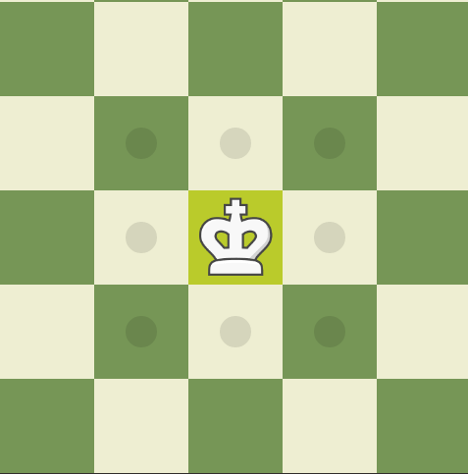
The King
Moves 1 in any direction
Cannot move into check
Captures 1 space in any direction

Slide 11

Special rules of chess

Slide 12

Pawn Promotions
Pawns have a special perk when they reach enemies back rank they get a promotion
Pawns can promote to a:
Rook
Queen
Bishop
Knight
Pawns cannot Promote to a king
Pawns can promote by capturing a piece on the back rank

Slide 13
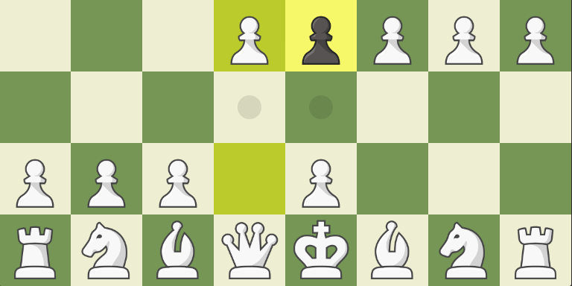
En Passant
En Passant is French term that when translated means “by the way” or “incidentily”
The En Passant rule states that a pawn making a first move of two squares instead of one may nevertheless be immediately captured by an adjacent pawn on the forth rank.
This was instated around the same time that the double move option for the pawn was as before if a pawn from the starting rank went to the 3rd rank as a pawn could only move 1 place forward a enemy pawn on the 4th rank would have captured it
It is the only capture in chess which the piece that is capturing does not end up on the same space as the captured piece
En Passant is only allowed right after the pawn has moved if En passant is not taken immediately it no longer is available

Slide 14
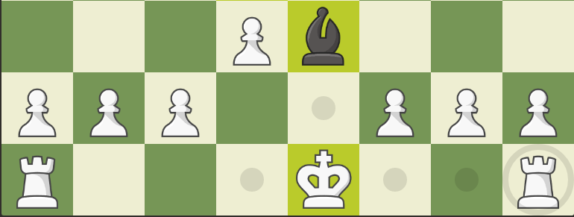
Castling for the King and Rook
If the King and the rook you want to castle with have not moved and there are no pieces between them the king can castle
Castling entails the king moving 2 places to the left or the right and the corresponding rook on that side moving next to the king on the outside.
Castling is not permitted when a enemy piece can move in between the rook and the king or the king is in check
If the king or the rook that you want to castle with has moved Castling rights are cancelled either for that rook or for you if the king has moved

